Slide 1
Syntax Analysis

Slide 2


Steps in NLP
Morphological Analysis
John Ate the Apple
Ate the Apple John
Syntactic analysis
Semantic Analysis
Discourse Analysis
Pragmatic Analysis

Slide 3
Tagging
Tagging is a kind of classification that may be defined as the automatic assignment of description to the tokens.
Here the descriptor is called tag, which may represent one of the part-of-speech, semantic information and so on.
parts of speech are defined instead based on their grammatical relationship with neighboring words or the morphological properties about their affixes

Slide 4
Part-of-Speech (PoS) tagging
the process of assigning one of the parts of speech to the given word
POS tagging is a task of labelling each word in a sentence with its appropriate part of speech
Examples of Parts Of Speech – nouns, verb, adverbs, adjectives, pronouns, conjunction and their sub-categories

Slide 5
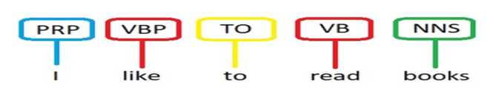
POS Tagging Example
Annotate each word in a sentence with a part-of-speech.
A POS tagger considers surrounding words while assigning a tag.
[(“I”, “Pronoun”), (“like”, “Verb”), (“to”, “To”), (“read”, “Verb”), (“books”, “Noun”)]

Slide 6
Categories of Parts of Speech
Closed class
Open class

Slide 7
Open Class (Mostly Content word)
Called open class because we will keep on adding new words in the language example google,skype,photoshop
Noun,verbs,adjective,adverbs
Mostly content bearing –they refer to objects,actions,and features in the world

Slide 8
Close class (function words)
Pronoun, determiner, prepositions, connectives
Limited in number
Used to tie the concepts of the sentences together we user these closed words

Slide 9
POS tags: level of Details
How much detail we want to specify the particular category
Level of details of POS Tag
Coarse grained Fine grained
Decision in dependent on the application

Slide 10
Coarse Grained(Small Tag Set)
Here we do not provide the pos tag in much details(Grammatical Details)
For example –we can identify a word as NOUN but we can not tell whether it Singular Noun or Plural Noun

Slide 11
Fines grained (Large Tag set)
In fine grained level we provide grammatical details of a word
For example if Verb then is it past tense ,future or present tense
NOTE :May Leads to confusion due to too many POS tags

Slide 12
POS TAG / Word Classes
9 traditional word classes of parts of speech
Noun, verb, adjective, preposition, adverb, article, pronoun, conjunction, interjection
N noun chair, bandwidth, pacing
V verb study, debate, munch
ADJ adjective purple, tall, ridiculous
ADV adverb unfortunately, slowly
P preposition of, by, to
PRO pronoun I, me, mine
DET determiner the, a, that, those
12
Notes:
12

Slide 13
Part-of-speech tagging
Tagging is a disambiguation task;
words are ambiguous
—have more than one possible part-of-speech
—and the goal is to find the correct tag for the situation.
For example, book can be a verb (book that flight) or a noun (hand me that book).

Slide 14
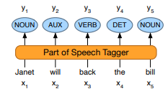
Part-of-speech tagging
process of assigning a part-of-speech to each word in part-of-speech tagging a text.
input →sequence x1, x2,..., xn of (tokenized) words and a tagset,
Output → is a sequence y1, y2,..., yn of tags,
each output yi corresponding exactly to one input xi as shown below

Slide 15
POS Tagging is disambiguation task
Words are ambiguous(more than one possible part-of-speech)
the goal is to find the correct tag for the situation
For example,
book can be a verb (book that flight)
Or
a noun (hand me that book)
The goal of POS-tagging is to resolve these ambiguity resolution ambiguities, choosing the proper tag for the context

Slide 16
Part-of-Speech Tag sets
There are various tag sets to choose.
•The choice of the tag set depends on the nature of the application.
–We may use small tag set (more general tags) or
–large tag set (finer tags).
•Some of widely used part-of-speech tag sets:
–Penn Treebank has 45 tags
–Brown Corpus has 87 tags
–C7 tag set has 146 tags
•In a tagged corpus, each word is associated with a tag from the used tag set.

Slide 17
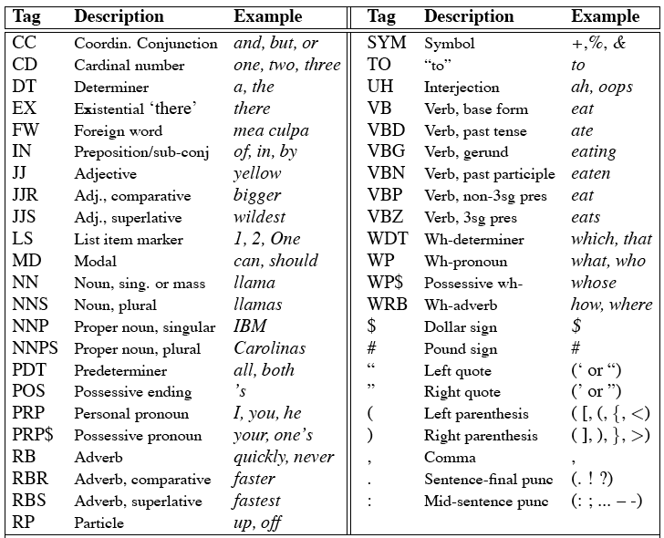
Penn Treebank Tagset
17
Notes:
17

Slide 18
POS Tagging Approaches
Rule-based tagging
E.g. EnCG ENGTWOL tagger
Stochastic, or, Probabilistic tagging
HMM (Hidden Markov Model) tagging
Transformation-based tagging
Learned rules (statistic and linguistic)
E.g., Brill tagger
18
Notes:
18

Slide 19
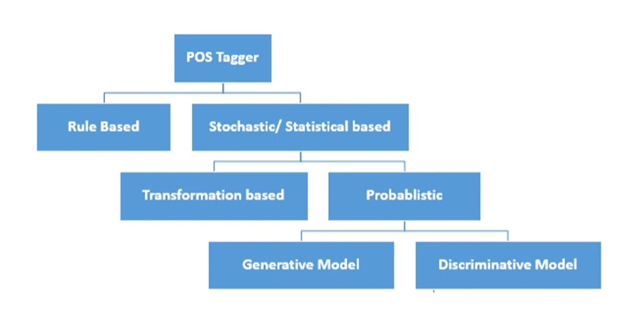
POS Tagging Approaches

Slide 20
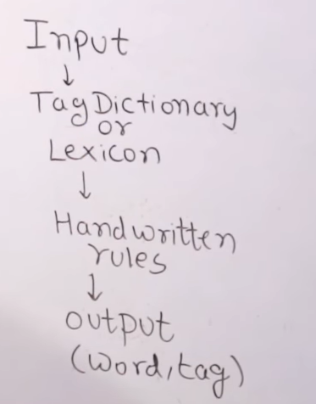
Rule Based POS Tagging Approaches
Input:- Sentence
Tag dictionary /Lexicon-Using Tag dictionary POS tags will be assigned to the words in the given sentence
For Example :-
I play cricket everyday (Play is Verb)
I want to perform a play (Play is Noun )
(Here play has two tags Noun and Verb Ambiguous POS )
Handwritten rules-
For example an Ambiguous word is noun if it follows a determiner

Slide 21
Rule-Based Tagging
The rule-based approach uses handcrafted sets of rules to tag input sentence.
Stage 1:
Typically…start with a dictionary of words and possible tags
Assign all possible tags to words using the dictionary
Stage 2:
Write rules by hand to selectively remove tags
Stop when each word has exactly one (correct) tag
21
Notes:
21

Slide 22
Rules based on context
Please book that flight
I bought a Book.
Rule-1: if (the previous word is “to”)
then eliminate all Noun tags
•Rule-2: if (the previous tag is an article)
then eliminate all verb tags
Book
Book
W_{n-1}
W_{n+1}
T_{n+1}
W_{n}
T_{n-1}
T_{n}

Slide 23
Apply Rules Eliminating Some POS
E.g., Eliminate VBN if VBD is an option when VBN|VBD follows “<start> PRP”
NN
RB
JJ VB
PRP VBD TO VB DT NN
She promised to back the bill
23
Notes:
23
VBN: part participle
VBD: past tense

Slide 24
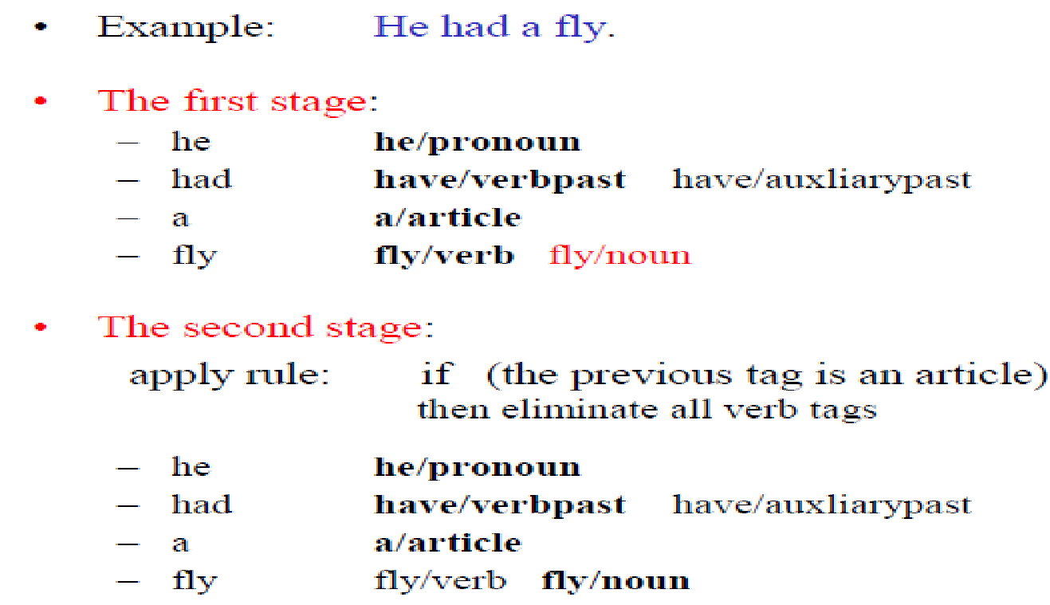
Rule-Based Part-of-Speech Tagging: Example
Pronoun
Verb
Article
Verb Noun
Pronoun
Verb
Article
Verb Noun

Slide 25
Rule Base Tagger
It is oldest approach and uses hand written rules for tagging
Depends on dictionary or lexicon to get possible tags for each word to tagged
Language experts will sit together to find out what are the symbol patterns.
Hand written rules are used to identify the correct tag when the word has more than one possible tag.
Disambiguation is done by analysing the linguistic features of the word, its preceding word following word and other aspects .

Slide 26
Rule Base Tagger
For example, if the preceding word is article, then the word must be a noun. ​
​We can also understand Rule-based POS tagging by its two-stage architecture −
The first stage − In the first stage, create a dictionary to assign each word a list of potential parts-of-speech.
The second stage − In the second stage, create a large list of hand-written disambiguation rules to sort down the list to a single part-of-speech for each word as per requirements.
TAGGIT the first large rule-based tagger used context pattern rules.​
​
TAGGIT used the set of 71 tags and 3300 disambiguation rules.​
These rules disambiguated 77% of words in the million –word brown.​

Slide 27
Example
University Corpus
I want to read a book.
Book-Noun or Verb
Rule :-Before book ,determiner (a) is there ,therefore it is a noun.

Slide 28
Limitation of Rule based Approach
Hard coded rules are required
Rules has to be updated based on language change
It needs to check lexicon every time which is not efficient approach
Strong language expert team is required.

Slide 29
Hidden Markov Model
An HMM is a probabilistic sequence model:
given a sequence of units (words, letters, morphemes, sentences, whatever), it computes a probability distribution over possible sequences of labels and chooses the best label sequence.

Slide 30
Markav Chain
Markov chains, named after Andrey Markov, a stochastic model that depicts a sequence of possible events
where predictions or probabilities for the next state are based solely on its previous event state, not the states before.
In simple words, the probability that n+1th steps will be x depends only on the nth steps not the complete sequence of steps that came before n.
This property is known as Markov Property or Memorylessness.
Let us explore our Markov chain with the help of a diagram,

Slide 31
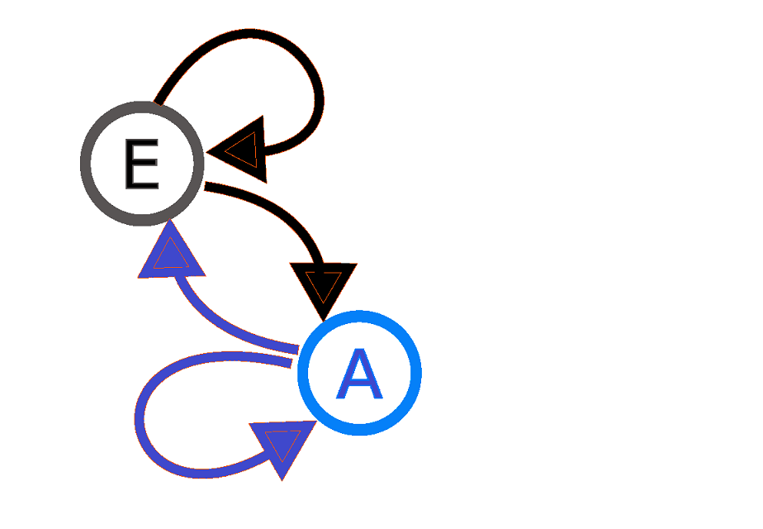
A diagram representing a two-state(here, E and A) Markov process.
Here the arrows originated from the current state and point to the future state and the number associated with the arrows indicates the probability of the Markov process changing from one state to another state.
For instance, if the Markov process is in state E, then the probability it changes to state A is 0.7, while the probability it remains in the same state is 0.3. Similarly, for any process in state A, the probability to change to E state is 0.4 and the probability to remain in the same state is 0.6.

Slide 32
Markov Chain
tells us something about the probabilities of sequences of random variables, states, each of which can take on values from some set
These sets can be words or tags or symbol representing anything for example weather
Markov Assumption
if we want to predict the future in the sequence, all that matters is the current state.
All the states before the current state have no impact on the future except via the current state.

Slide 33
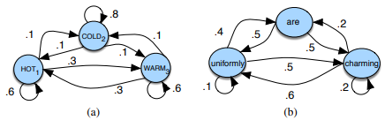

Slide 34
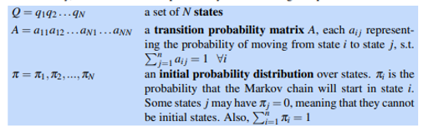
Markov chain is specified by the following components:

Slide 35
The Hidden Markov Model
A Markov chain is useful when we need to compute a probability for a sequence of observable events
In many cases, however, the events we are interested in are hidden : we don’t observe them directly
For example we don’t normally observe part-of-speech tags in a text. Rather, we see words, and must infer the tags from the word sequence. We call the tags hidden because they are not observed

Slide 36
A hidden Markov model
A hidden Markov model (HMM) allows us to talk about both
observed events (like words that we see in the input) and
hidden events (like part-of-speech tags) that we think of as causal factors in our probabilistic model.

Slide 37
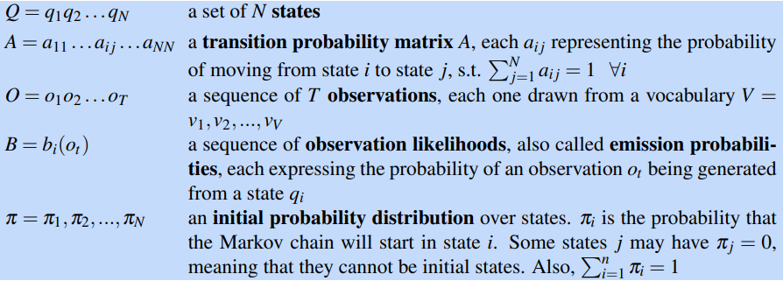
HMM is specified by the following components

Slide 38
A first-order hidden Markov model instantiates two simplifying assumptions.
First, as with a first-order Markov chain, the probability of a particular state depends only on the previous state:
Second, the probability of an output observation oi depends only on the state that produced the observation qi and not on any other states or any other observations:

Slide 39
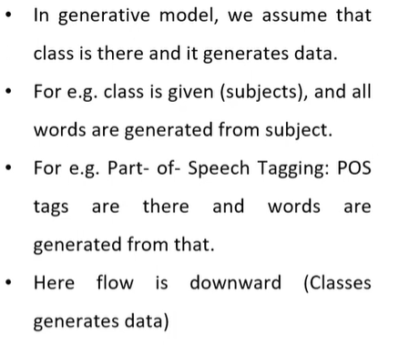
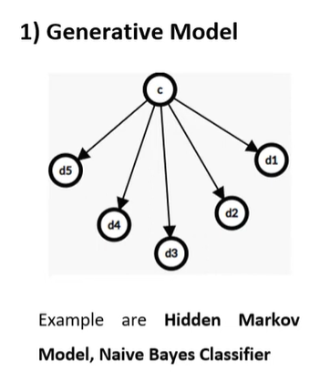

Slide 40
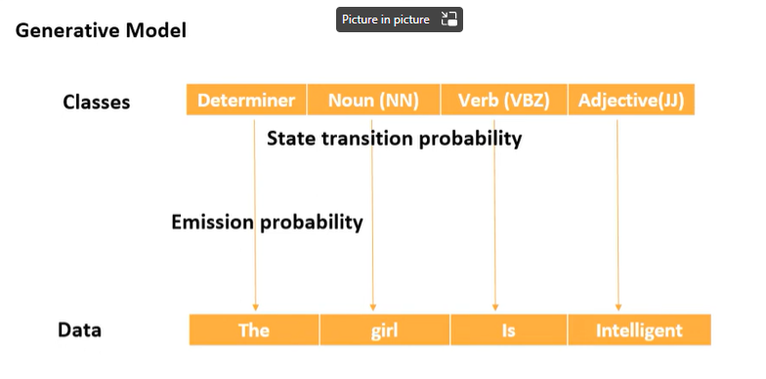
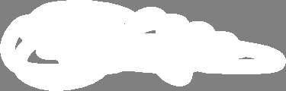
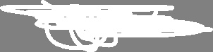

Slide 41
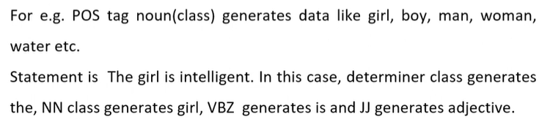

Slide 42
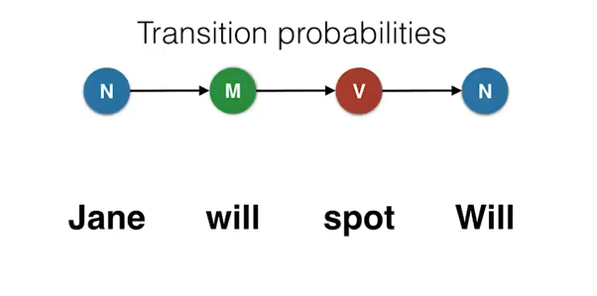

Slide 43
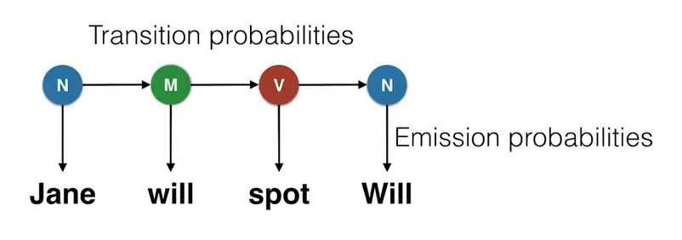

Slide 44
Transition probability
The transition probability is the likelihood of a particular sequence for example, how likely is that a noun is followed by a model and a model by a verb and a verb by a noun.
This probability is known as Transition probability. It should be high for a particular sequence to be correct.
Emission probability :
These sets of probabilities are Emission probabilities and should be high for our tagging to be likely.
Now, what is the probability that the word Ted is a noun, will is a model, spot is a verb and Will is a noun.

Slide 45
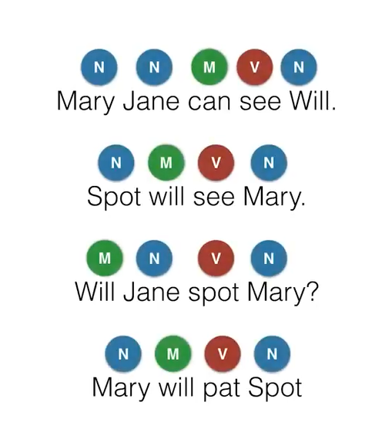

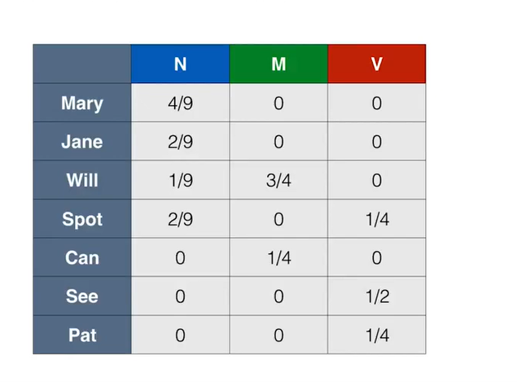

Slide 46
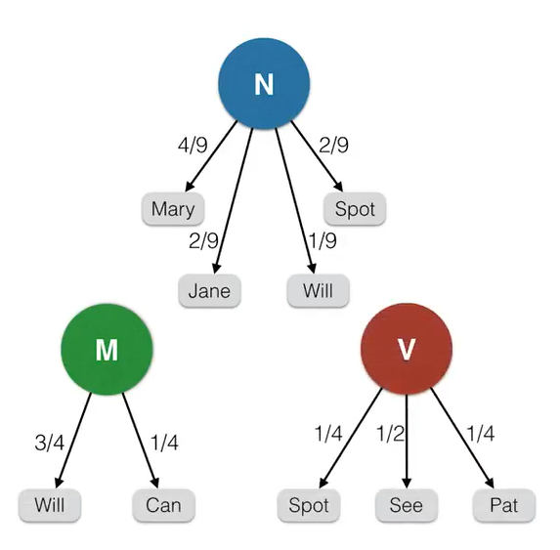

Slide 47

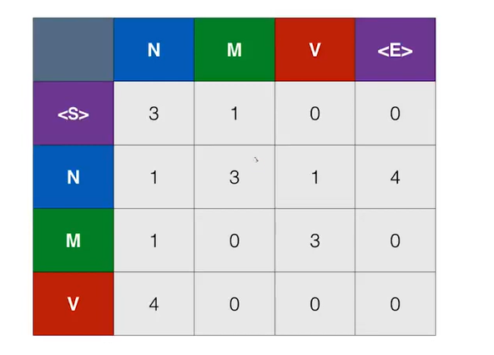
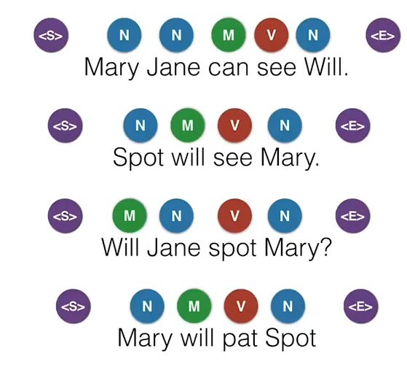

Slide 48
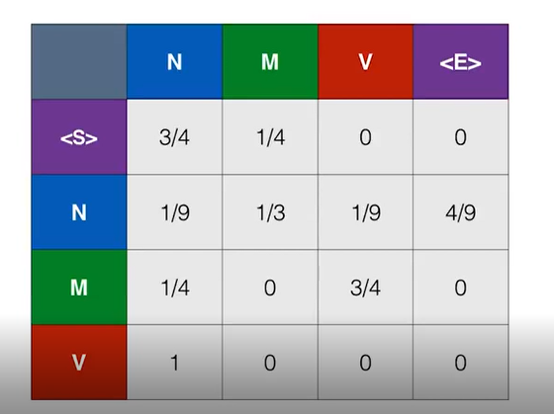

Slide 49
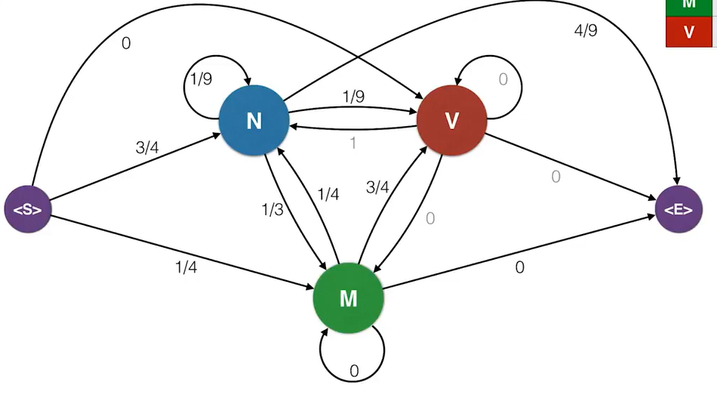
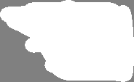

Slide 50
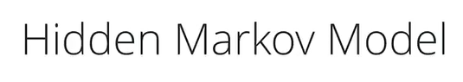
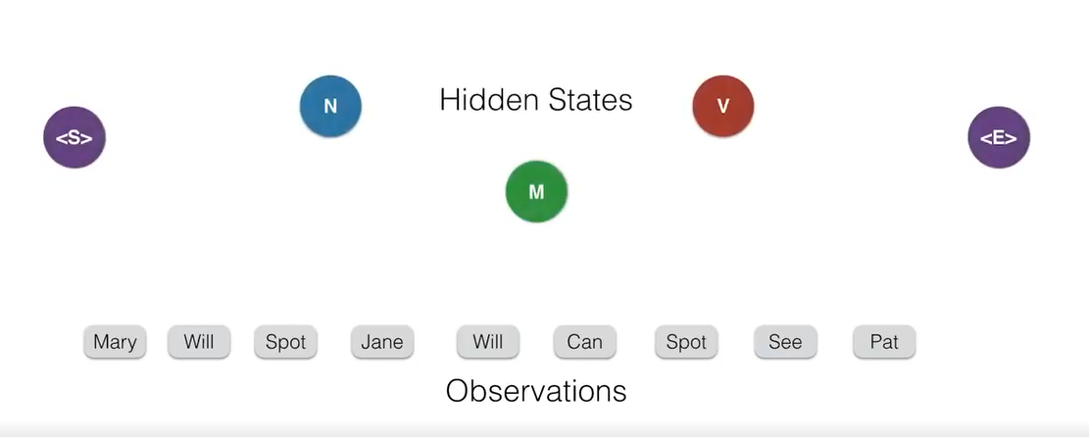

Slide 51
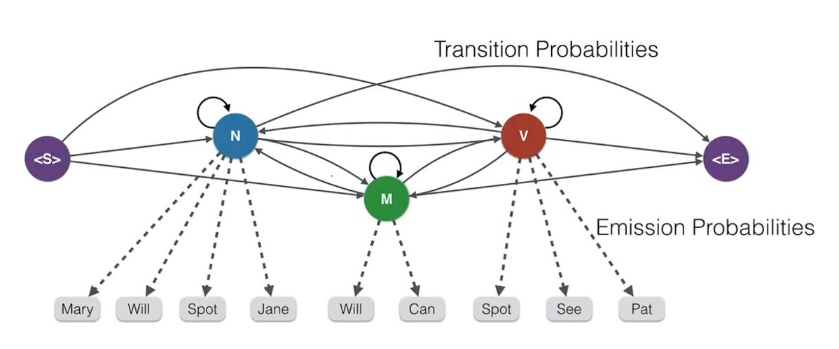

Slide 52
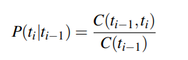
The components of an HMM tagger
An HMM has two components, the A and B probabilities
The A matrix contains the tag transition probabilities P(ti |ti−1) which represent the probability of a tag occurring given the previous tag.
For example, modal verbs like will are very likely to be followed by a verb in the base form, a VB, like race, so we expect this probability to be high.
We compute the maximum likelihood estimate of this transition probability by counting, out of the times we see the first tag in a labeled corpus, how often the first tag is followed by the second:

Slide 53
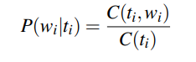
The B emission probabilities, P(wi |ti), represent the probability, given a tag (say MD), that it will be associated with a given word (say will).
The MLE of the emission probability is

Slide 54
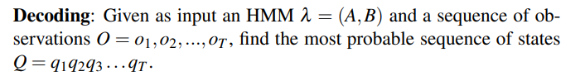
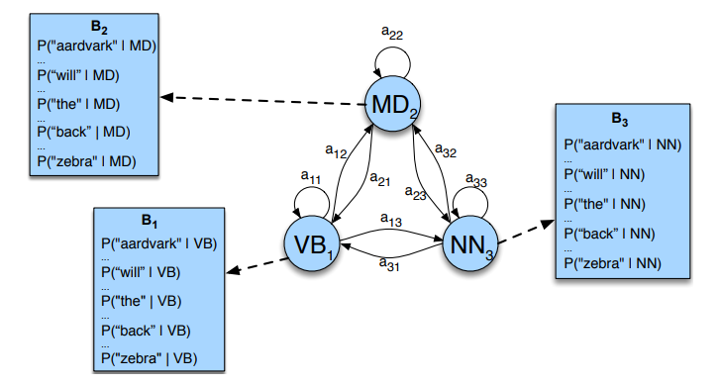
HMM tagging as decoding
HMM contains hidden variables, the task of determining the hidden variables sequence corresponding to the sequence of observations decoding is called decoding.

Slide 55
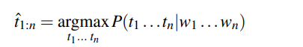
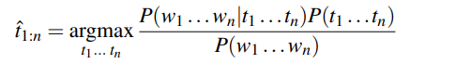
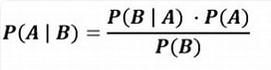
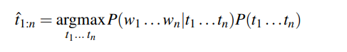

For part-of-speech tagging, the goal of HMM decoding is to choose the tag sequence t1 ...tn that is most probable given the observation sequence of n words w1 ...wn:
The way we’ll do this in the HMM is to use Bayes’ rule to instead compute:
Furthermore, we simplify Eq. Above by dropping the denominator P(w n 1 ):

Slide 56
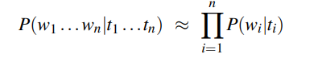
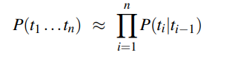



HMM taggers make two further simplifying assumptions.
The first is that the probability of a word appearing depends only on its own tag and is independent of neighboring words and tags:
The second assumption, the bigram assumption, is that the probability of a tag is dependent only on the previous tag, rather than the entire tag sequence;

Slide 57
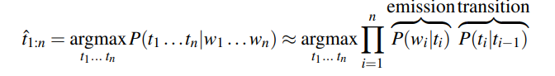
Plugging the simplifying assumptions from Eq. X and Eq. Y into Eq. Z results in the following equation for the most probable tag sequence from a bigram tagger:

Slide 58
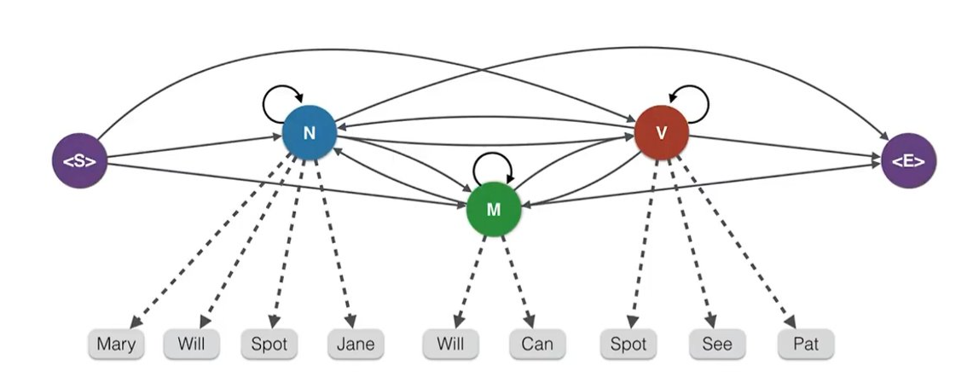
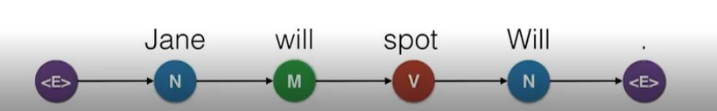
Find the probability of the following sentence :Jane will spot Will

Slide 59
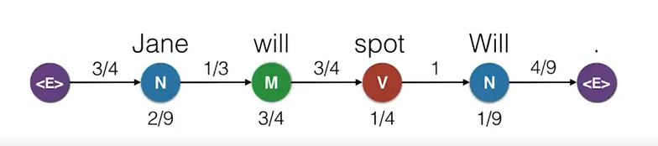
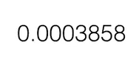
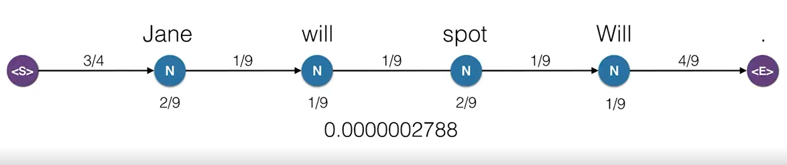

Slide 60
JANE | will | spot | will
Noun | noun | noun | noun
 | Modal verb | Verb | Modal verb

Slide 61
How to find the correct path ?
In general, we from all the possible combination of parts of speech tags we will pick the one that generates the above sentence Jane will spot Will with the highest probability

Slide 62
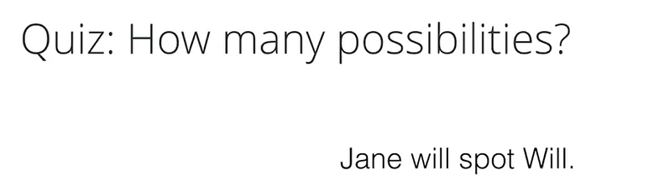
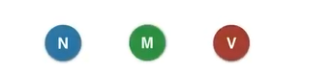

Slide 63
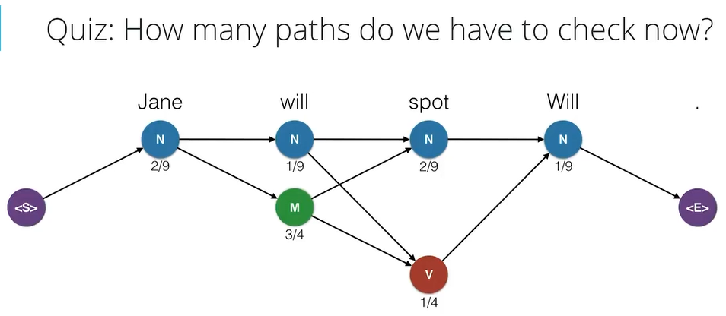

Slide 64
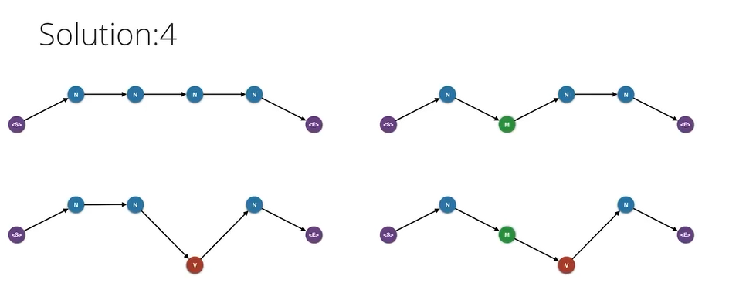
Which one of this generates the sentence with highest probability ?

Slide 65
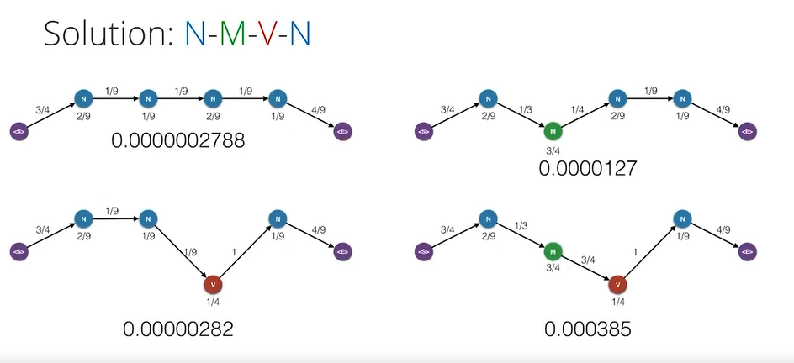

Slide 66


Slide 68


Slide 69


Slide 70

For every possible state we require the highest probability path that ends in that state .
This is known as Viterbi HMM Algorithm

Slide 71



Slide 72


Emission Probability Matrix
Transition Probability Matrix

Slide 73


Slide 74


Slide 75


Slide 76


Slide 77


Slide 78


Slide 79


Slide 80


Slide 81


Slide 82


Slide 83
We keep the edge which gives us a high value and remembering the edge which gives us a highest value .
We have all the probabilities and edges which gives those probabilities.
To get the optimal path, we start from end and trace backwards
Each state has only one incoming edge ,this will give us optimal path with highest probabilities .

Slide 84


Slide 85



